Slide 1
Lecture-7
Chapter-14.4
Computer Organization and Architecture Designing - William Stallings
Instruction Pipelining

Slide 2
Stages of Pipelining
Fetch Instruction (FI)
Decode Instruction (DI)
Calculate Operands (CO)
Fetch Operands (FO)
Execute Instructions (EI)
Write Operands (WO)
Notes:
38

Slide 3
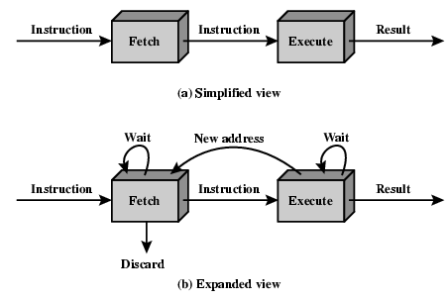
Two Stage Instruction Pipeline

Slide 4
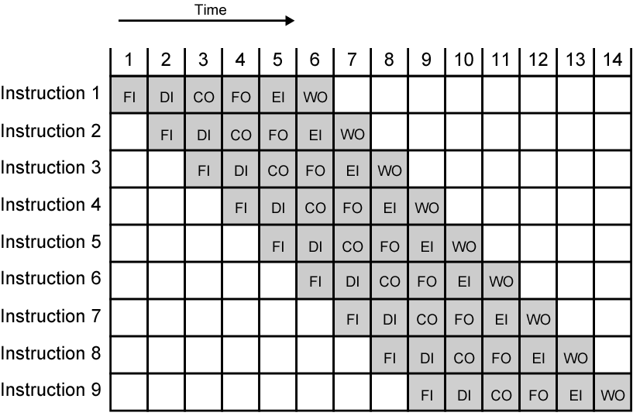
Timing Diagram for Instruction Pipeline Operation
Notes:
39

Slide 5
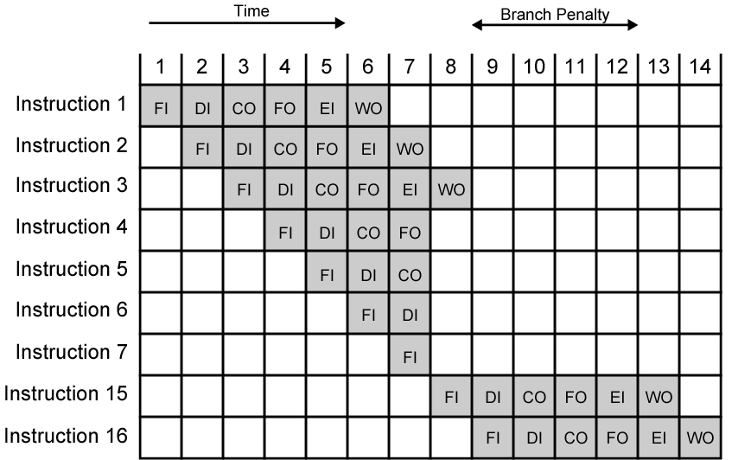
The Effect of a Conditional Branch on Instruction Pipeline Operation
Notes:
40

Slide 6
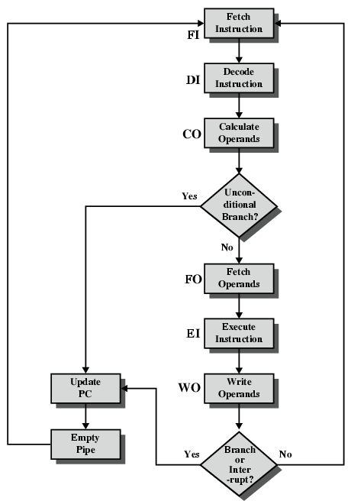
Six Stage Instruction Pipeline

Slide 7
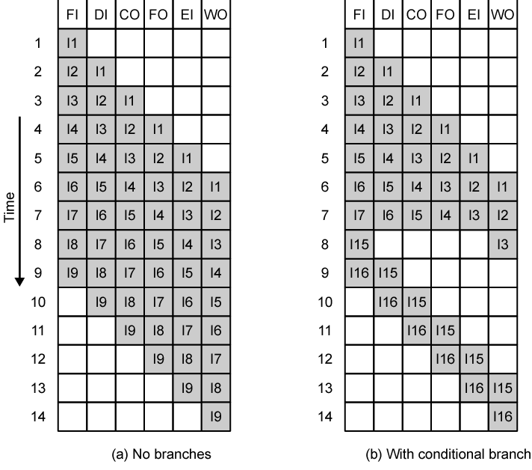
Alternative Pipeline Depiction

Slide 8
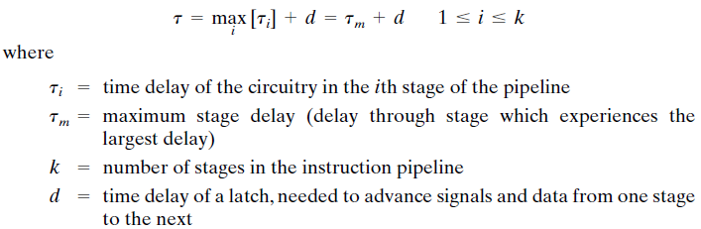
Pipeline Performance
The cycle time of an instruction pipeline is the time needed to advance a set of instructions one stage through the pipeline
The cycle time can be determined as

Slide 9

Pipeline Performance
Now suppose that n instructions are processed, with no branches. Let be the total time required for a pipeline with k stages to execute n instructions. Then
The speedup factor for the instruction pipeline compared to execution without the pipeline is defined as

Slide 10
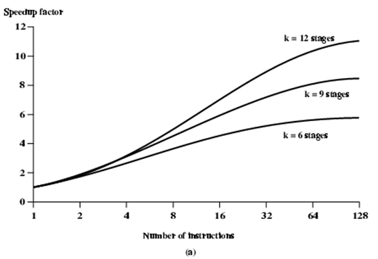
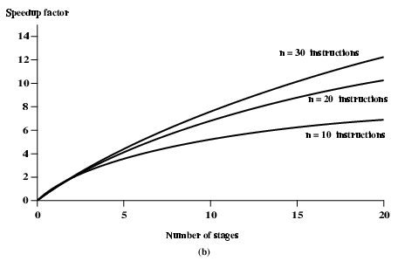
Speedup Factors with Instruction Pipelining

Slide 11
Pipeline Hazards
Pipeline, or some portion of pipeline, must stall
Also called pipeline bubble
Types of hazards
Resource
Data
Control

Slide 12
Resource Hazards
Two (or more) instructions in pipeline need same resource
Executed in serial rather than parallel for part of pipeline
Also called structural hazard
E.g. Assume simplified five-stage pipeline
Each stage takes one clock cycle
Ideal case is new instruction enters pipeline each clock cycle
Assume main memory has single port
Assume instruction fetches and data reads and writes performed one at a time
Ignore the cache
Operand read or write cannot be performed in parallel with instruction fetch
Fetch instruction stage must idle for one cycle fetching I3
E.g. multiple instructions ready to enter execute instruction phase
Single ALU
One solution: increase available resources
Multiple main memory ports
Multiple ALUs

Slide 13
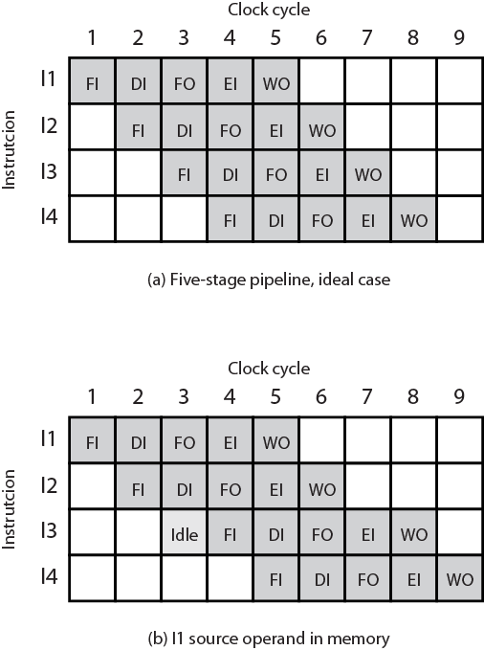
Resource Hazard Diagram

Slide 14
Data Hazards
Conflict in access of an operand location
Two instructions to be executed in sequence
Both access a particular memory or register operand
If in strict sequence, no problem occurs
If in a pipeline, operand value could be updated so as to produce different result from strict sequential execution
E.g. x86 machine instruction sequence:
ADD EAX, EBX /* EAX = EAX + EBX
SUB ECX, EAX /* ECX = ECX – EAX
ADD instruction does not update EAX until end of stage 5, at clock cycle 5
SUB instruction needs value at beginning of its stage 2, at clock cycle 4
Pipeline must stall for two clocks cycles
Without special hardware and specific avoidance algorithms, results in inefficient pipeline usage

Slide 15
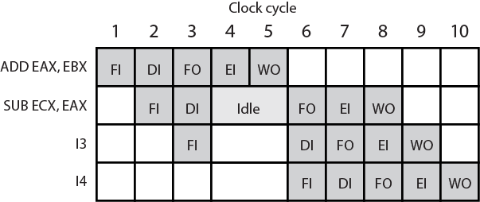
Data Hazard Diagram

Slide 16
Types of Data Hazard
Read after write (RAW), or true dependency
An instruction modifies a register or memory location
Succeeding instruction reads data in that location
Hazard if read takes place before write complete
Write after read (WAR), or antidependency
An instruction reads a register or memory location
Succeeding instruction writes to location
Hazard if write completes before read takes place
Write after write (WAW), or output dependency
Two instructions both write to same location
Hazard if writes take place in reverse of order intended sequence
Previous example is RAW hazard

Slide 17
Write After Read (WAR)
(i2 tries to write a destination before it is read by i1) A write after read (WAR) data hazard represents a problem with concurrent execution.
Example
For example:
i1. R4 <- R1 + R3 i2. R3 <- R1 + R2
If we are in a situation that there is a chance that i2 may be completed before i1 (i.e. with concurrent execution) we must ensure that we do not store the result of R3 before i1 has had a chance to fetch the operands.

Slide 18
Write After Write (WAW)
(i2 tries to write an operand before it is written by i1) A write after write (WAW) data hazard may occur in a concurrent execution environment.
Example
For example:
i1. R2 <- R4 + R7 i2. R2 <- R1 + R2
We must delay the WB (Write Back) of i2 until the execution of i1.

Slide 19
Control Hazard
Also known as branch hazard
Pipeline makes wrong decision on branch prediction
Brings instructions into pipeline that must subsequently be discarded
Dealing with Branches
Multiple Streams
Prefetch Branch Target
Loop buffer
Branch prediction
Delayed branching
Notes:
41

Slide 20
Multiple Streams
Have two pipelines
Prefetch each branch into a separate pipeline
Use appropriate pipeline
Leads to bus & register contention
Multiple branches lead to further pipelines being needed
Notes:
42

Slide 21
Prefetch Branch Target
Target of branch is prefetched in addition to instructions following branch
Keep target until branch is executed
Used by IBM 360/91
Notes:
43

Slide 22
Loop Buffer
Very fast memory
Maintained by fetch stage of pipeline
Check buffer before fetching from memory
Very good for small loops or jumps
c.f. cache
Used by CRAY-1
Notes:
44

Slide 23
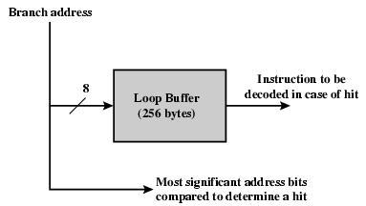
Loop Buffer Diagram

Slide 24
Branch Prediction
Various techniques can be used to predict whether a branch will be taken or not.
Predict never taken
Assume that jump will not happen
Always fetch next instruction
68020 & VAX 11/780
VAX will not prefetch after branch if a page fault would result (O/S v CPU design)
Predict always taken
Assume that jump will happen
Always fetch target instruction
Notes:
45

Slide 25
Branch Prediction
Predict by Opcode
Some instructions are more likely to result in a jump than others
Can get up to 75% success
Taken/Not taken switch
Based on previous history
Good for loops
Refined by two-level or correlation-based branch history
Correlation-based
In loop-closing branches, history is good predictor
In more complex structures, branch direction correlates with that of related branches
Use recent branch history as well
Delayed Branch
Do not take jump until you have to
Rearrange instructions
Notes:
46

Slide 26
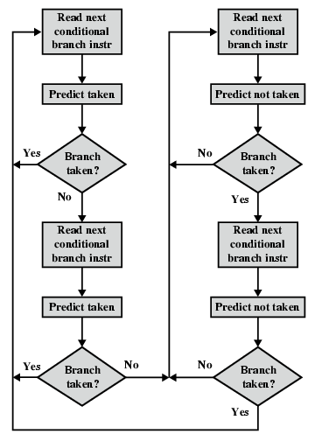
Branch Prediction Flowchart

Slide 27
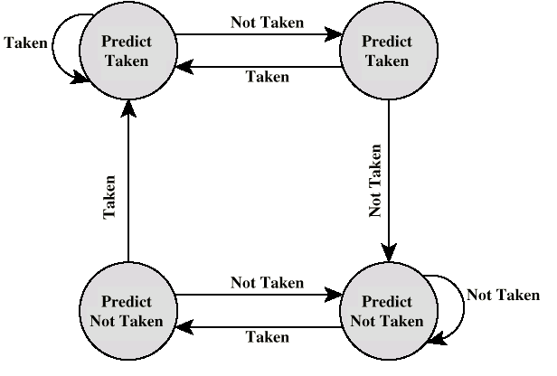
Branch Prediction State Diagram

Slide 28
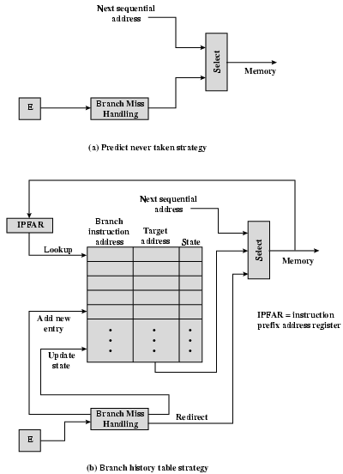
Dealing With Branches
It is possible to improve pipeline performance by automatically rearranging instructions within a program, so that branch instructions occur later than actually desired.

Slide 29
That’s All Thank You

